Slide 1
Customer Satisfaction on online food delivery
Guide: Prof. Srinivasa Reddy Konda

Slide 2
TEAM MEMBERS
K.SAI DEEPAK 20BCD7092
G.HARISH 20BCD7101
U.MANISH 20BCE7589

Slide 3
AGENDA
Abstarct
Literature review
​Methodology
Results
​conclusion​

Slide 4
Abstract
Online food delivery (OFD) is no longer a new concept for the majority of people. This type of business delivery has become very popular, especially among young, busy and working people. This study will be conducted to investigate customer intentions to use OFD services through the evaluation of satisfaction, food quality, and OFD service quality.
The OFD service quality will be evaluated by including service convenience, customer service, and service fulfilment. The study determines that food quality, control, customer service, and service fulfilment affect customer satisfaction in online food delivery services. Online ordering is the new eating out, not just for takeout or eating out. The emergence of online grocery delivery services can be attributed to the changing nature of urban consumers.
Furthermore, a significant positive relationship was observed not only between website trust and customer satisfaction, but also between customer satisfaction and loyalty. The data will be collected from the customers or users of any online food delivery service and will be analysed.

Slide 5
Literature review
Online food delivery services have become increasingly popular in recent years due to their convenience and ease of use. As a result, many studies have been conducted on customer satisfaction with these services. Here is a literature review of some of the key findings:
Quality of food
Delivery time
Order accuracy
Customer service:
Website/App interface
Price

Slide 6
Methodology
Research Design
Data Collection
Measures
Data Analysis
Results

Slide 7
Results

Slide 8
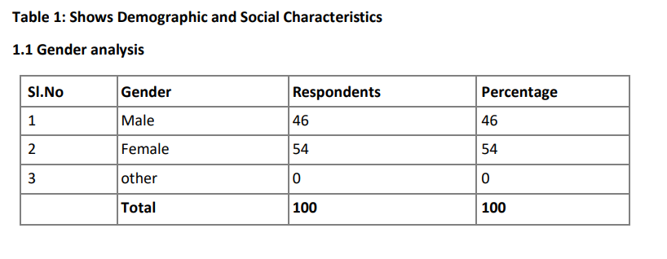
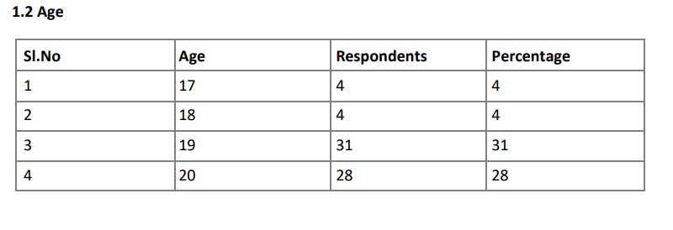

Slide 9
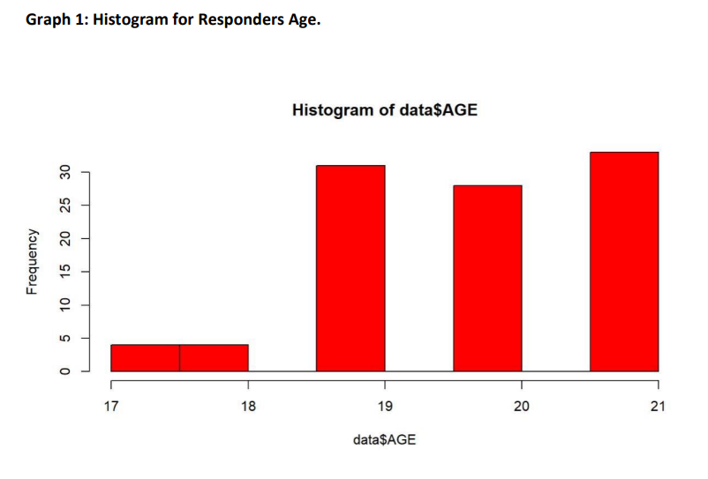
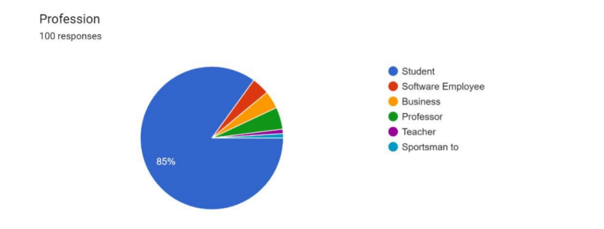

Slide 10
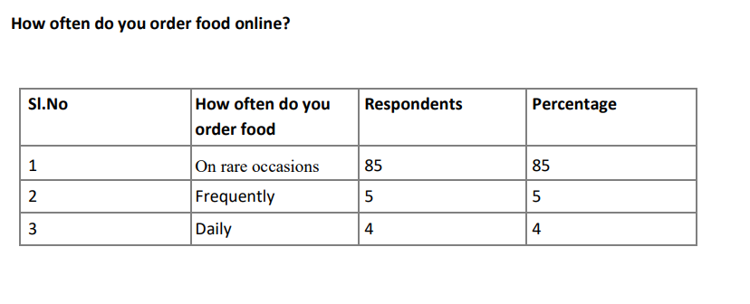
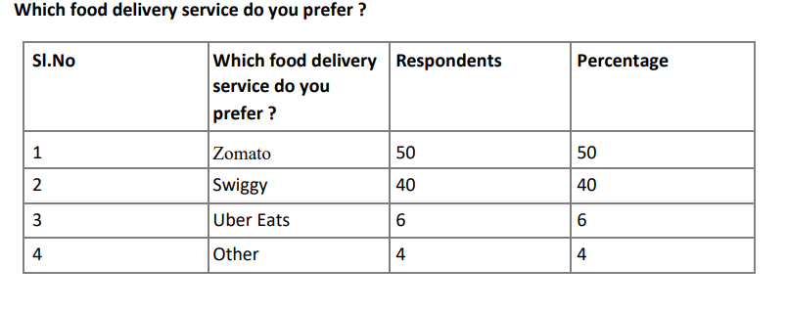

Slide 11
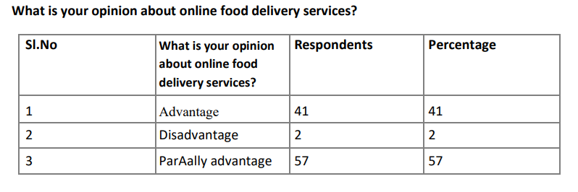
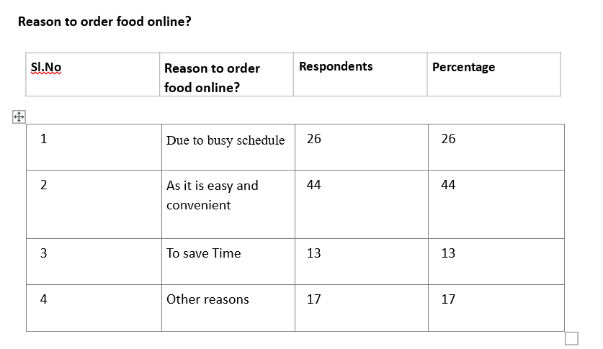

Slide 12
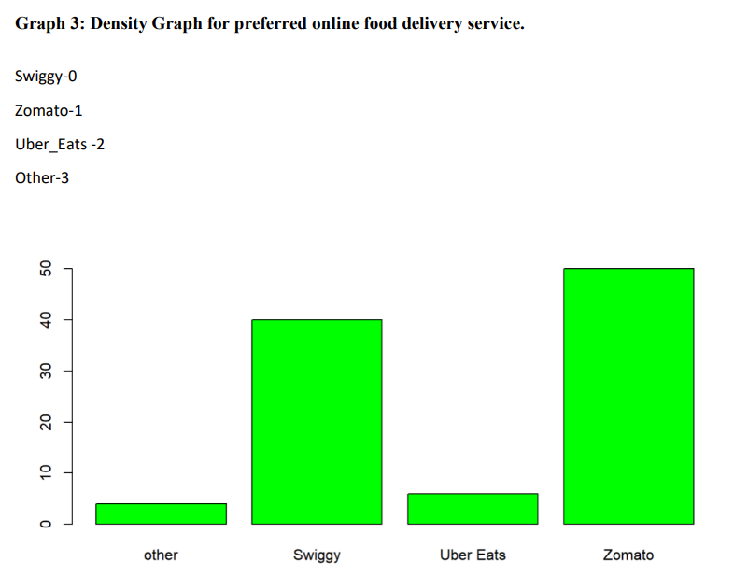

Slide 13



Slide 14
conclusion
This study focused on examining the relationship between e-service quality and e-satisfaction in online food ordering. The estimated factors were found to be significantly related to e-satisfaction. Ease of use also has a positive effect on customer satisfaction. Using our online ordering platform or mobile application can improve your expertise and increase customer satisfaction. This indicates that most online shoppers value information about available products and foods.
Therefore, in order to improve the online shopping experience, the seller or online grocer should use all the information necessary to successfully place an order.

Slide 15
THANK YOU
K.SAI DEEPAK 20BCD7092
G.HARISH 20BCD7101
U.MANISH 20BCE7589

